Slide 1

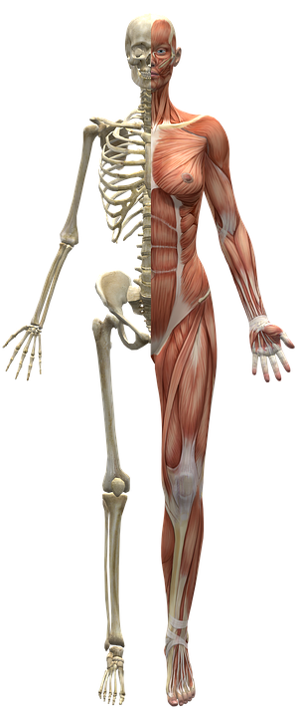

A Patient Oriented
Healthcare Initiative
Team classified

Slide 2
Our motivation
“ An Informed Patient Is A
Healthier Patient ”
~ Team Classified
The most intuitive way to convey the pain to a doctor is to point to ‘where it hurts’ What we want to do is to make this process virtual. Our objective is to make simple android application that adds another layer in the process of bridging the gap between doctors and their patients.

Slide 3

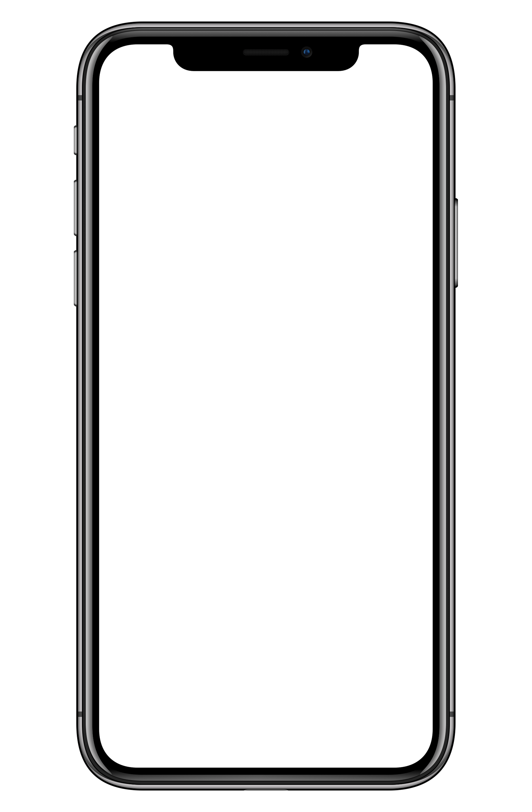



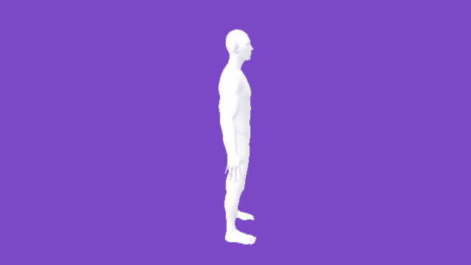

airtel
The app interface will include a 3-d model of human body which would be 360 degree rotatable and would include hold to point.
The user could just select the area where they suspect a problem and the application will identify the part of body in question.
WhereIt
Hurts

Slide 4
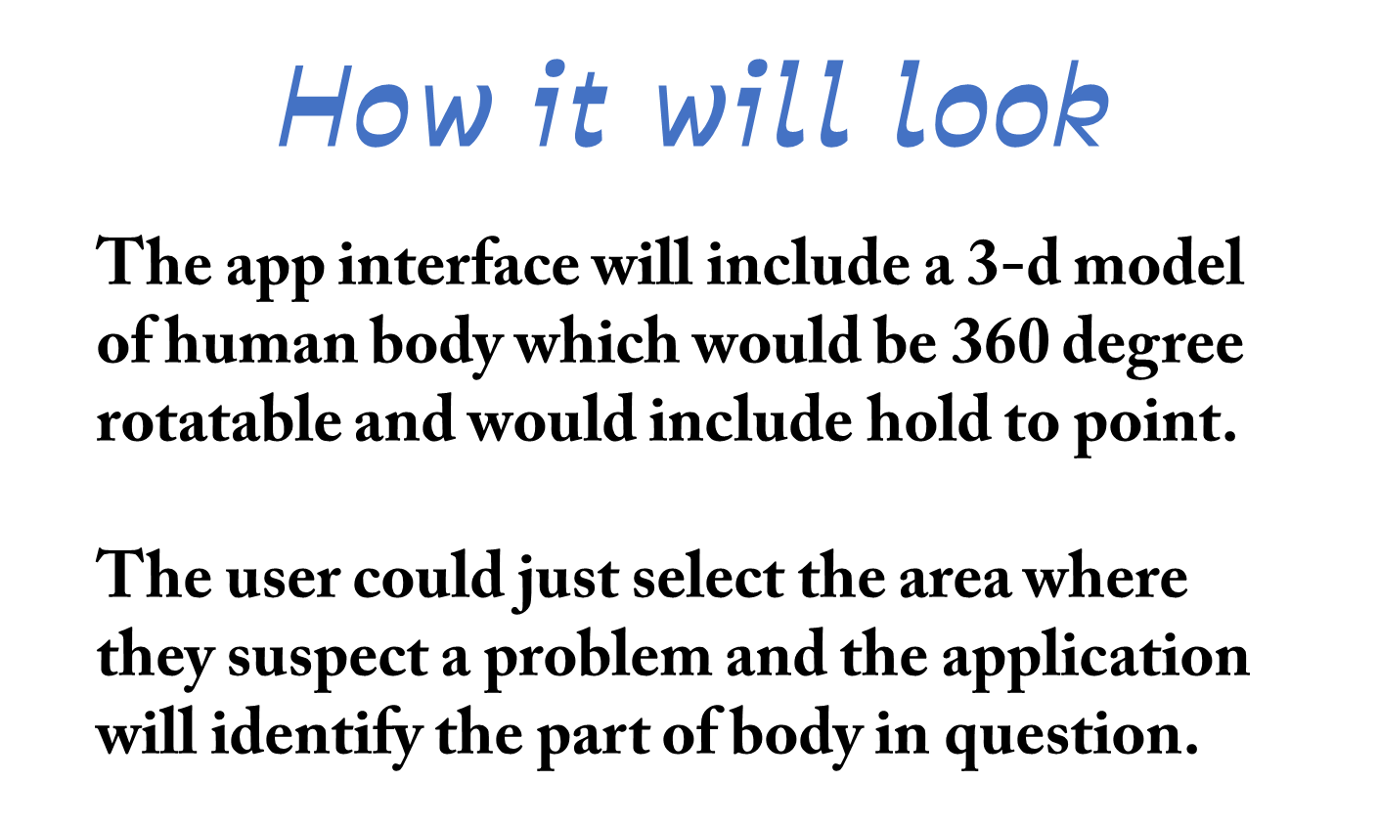
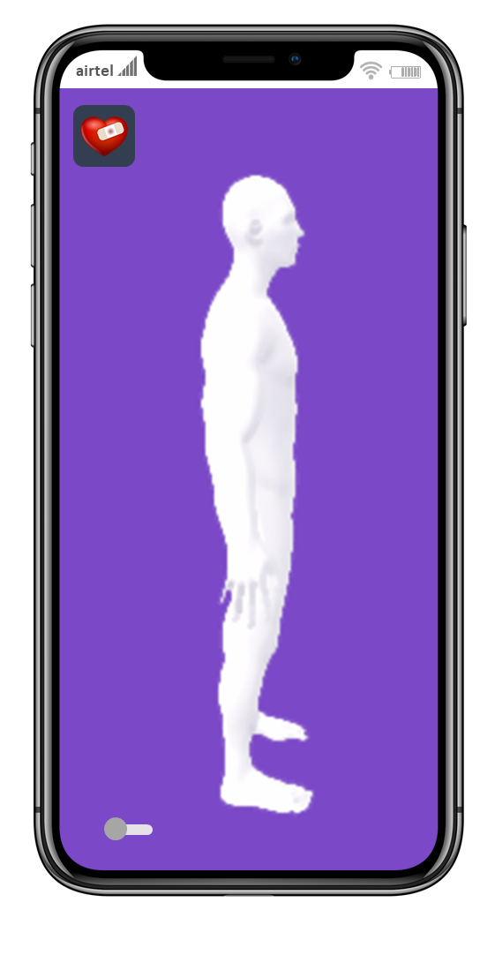

Slide 5
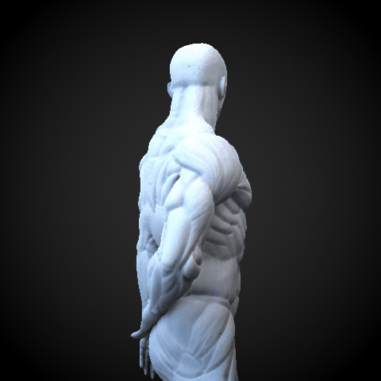
Why to use
airtel
The application is not just a bridge between the user and the doctor but also a first diagnostics app.
After the user points the initial location of discomfort, the app will search through its enormous library and will ask follow up question related to different symptoms that could be possible.
This will in-turn will help to triangulate the issue.

Slide 6

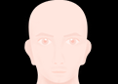






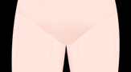

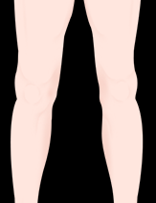

A 2D VISUALIZATION OF OUR IDEA

Slide 7
A 2D VISUALIZATION OF OUR IDEA
NEXT

Slide 8
ITS POSSIBLY AN ABDOMEN RELATED PROBLEM
DIZZINESS
VOMITING
INDIGESTION
DIARRHEA
FEVER
COUGH
COLD
OTHERS

Slide 9
ITS POSSIBLY AN ABDOMEN RELATED PROBLEM
DIZZINESS
VOMITING
INDIGESTION
DIARRHEA
FEVER
COUGH
COLD
OTHERS
NEXT

Slide 10
ITS POSSIBLY AN ABDOMEN RELATED PROBLEM
DIZZINESS
VOMITING
INDIGESTION
DIARRHEA
FEVER
COUGH
COLD
OTHERS
NEXT

Slide 11
POSSIBLE DISEASES ☹
TYPHOID
DENGUE
FOR FURTHER ACTIONS CONTACT YOUR NEAREST TYPHOID ,DENGUE DOCTORS CLICK HERE

Slide 12
DR. RIDHAM BHAT
+91-9911473900
DR. VEDANT AGGARWAL
+91-9810531967
DR. NAMAN JAIN
+91-9560645865
DR. S. DEY
+91-921142020

Slide 13
C
R
E
D
I
T
S
RIDHAM
SAYANTANU
VEDANT
NAMAN
TEAM CLASSIFIED

